Slide 1
Asynchronous programming

Slide 2
Table of content
Definitions
Basic Concepts:
Concurrent Programming
Multitasking
Parallel Processing
Task Execution
Concurrency and Python:
Issues
Why Use Python at All?
Python as a Framework
Comments

Slide 3
Definitions
Concurrency : Doing more than one thing at a time. Of particular interest to programmers writing code for running on big iron, but also of interest for users of multicore PCs. Usually a bad idea--except when it's not.

Slide 4
Basic Concepts. Concurrent Programming
Creation of programs that can work on more than one thing at a time
Example : A network server that communicates with several hundred clients all connected at once
Example : A big number crunching job that spreads its work across multiple CPUs

Slide 5
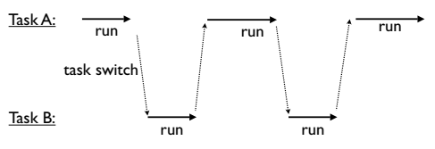
Basic Concepts. Multitasking
Concurrency typically implies "multitasking“
If only one CPU is available, the only way it can run multiple tasks is by rapidly switching between them

Slide 6
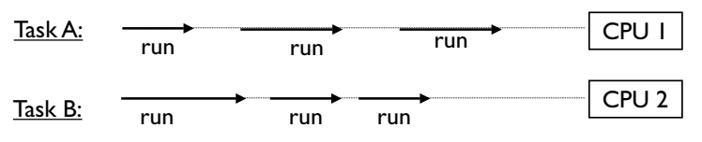
Basic Concepts. Parallel Processing
You may have parallelism (many CPUs)
Here, you often get simultaneous task execution
If the total number of tasks exceeds the number of CPUs, then each CPU also multitasks
Notes:
If the total number of tasks exceeds the number of CPUs, then each CPU also multitasks

Slide 7
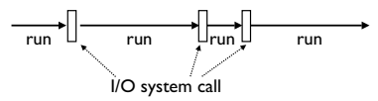
Basic Concepts. Task Execution
All tasks execute by alternating between CPU processing and I/O handling
For I/O, tasks must wait (sleep)
Behind the scenes, the underlying system will carry out the I/O operation and wake the task when it's finished
Notes:
If the total number of tasks exceeds the number of CPUs, then each CPU also multitasks

Slide 8

Basic Concepts. CPU Bound Tasks
A task is "CPU Bound" if it spends most of its time processing with little I/O
Examples:
Crunching big matrices
Image processing
Notes:
If the total number of tasks exceeds the number of CPUs, then each CPU also multitasks

Slide 9

Basic Concepts. I/O Bound Tasks
A task is "I/O Bound" if it spends most of its time waiting for I/O
Examples:
Reading input from the user
Networking
File processing
Most "normal" programs are I/O bound
Notes:
If the total number of tasks exceeds the number of CPUs, then each CPU also multitasks

Slide 10
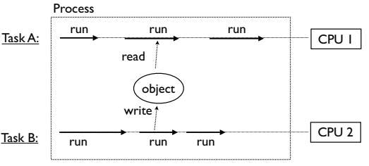
Basic Concepts. Shared Memory
Tasks may run in the same memory space
Simultaneous access to objects
Often a source of unspeakable peril
Notes:
If the total number of tasks exceeds the number of CPUs, then each CPU also multitasks

Slide 11
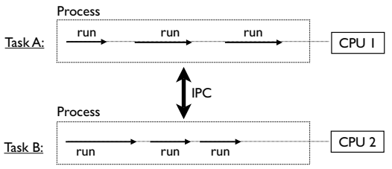
Basic Concepts. Processes
Tasks might run in separate processes
Processes coordinate using IPC
Pipes, FIFOs, memory mapped regions, etc.
Notes:
If the total number of tasks exceeds the number of CPUs, then each CPU also multitasks

Slide 12
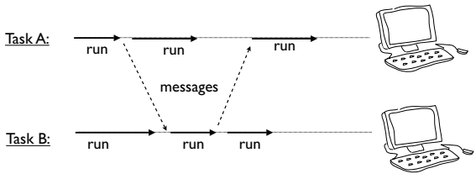
Basic Concepts. Distributed Computing
Tasks may be running on distributed systems
For example, a cluster of workstations
Communication via sockets
Notes:
If the total number of tasks exceeds the number of CPUs, then each CPU also multitasks

Slide 13
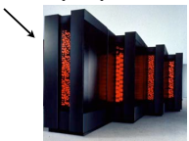
Concurrency and Python. Issues
Python is interpreted
"What the hardware giveth, the software taketh away.“
Frankly, it doesn't seem like a natural match for any sort of concurrent programming
Isn't concurrent programming all about high performance anyways???
Notes:
If the total number of tasks exceeds the number of CPUs, then each CPU also multitasks

Slide 14
Concurrency and Python. Why Use Python at All?
Python is a very high level language
And it comes with a large library
Useful data types (dictionaries, lists,etc.)
Network protocols
Text parsing (regexs, XML, HTML, etc.)
Files and the file system
Databases
Programmers like using this stuff...
Notes:
If the total number of tasks exceeds the number of CPUs, then each CPU also multitasks

Slide 15
Concurrency and Python. Python as a Framework
Python is often used as a high-level framework
The various components might be a mix of languages (Python, C, C++, etc.)
Concurrency may be a core part of the framework's overall architecture
Python has to deal with it even if a lot of the underlying processing is going on in C
Notes:
If the total number of tasks exceeds the number of CPUs, then each CPU also multitasks

Slide 16
Can Go Faster
Python can be extended with C code
Look at ctypes, Cython, Swig, etc.
If you need really high-performance, you're not coding Python--you're using C extensions
This is what most of the big scientific computing hackers are doing
It's called "using the right tool for the job"
Notes:
If the total number of tasks exceeds the number of CPUs, then each CPU also multitasks

